Slide 1


Basics of working with pupils with emotional and behavioral disorders
Monika Skura

Slide 2
definition of behavioural difficulties
"pupil with behavioural and emotional difficulties",
"pupil with behavioural and emotional disorders",
"pupil who violates discipline"
“any repeated pattern of behavior (…) that interferes with or is at risk of interfering with optimal learning or engagement in pro-social interactions with peers and adults” (Smith 2003)
pupils with emotional and behavioural challenges
special needs in areas such as classroom behaviour, social skills, learning at school
child in a class who is unsuccessful in learning or
who is unable to acquire the necessary learning and peer relations skills without help

Slide 3
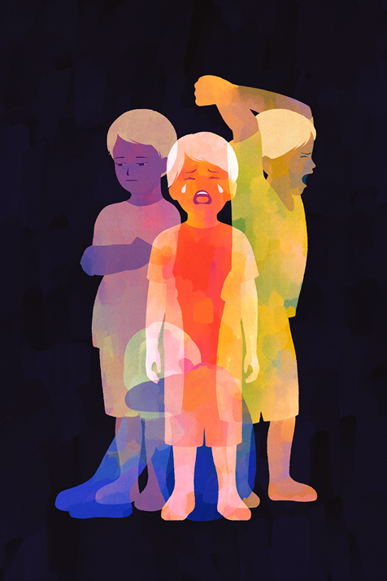
Determinants of dysfunctional child behaviour
Related to the child
- developmental crises, dysfunctions of the nervous system (ADHD), other mental disorders, health problems, temperamental traits etc.
Family-related
- parental mistakes, lack of parenting skills,
- pathology of family life, dysfunctions of family roles (a child receives inappropriate models of behaviour, is harmed, suffers psychological trauma, their needs are neglected).
Related to the functioning of the environment in the institution (school, common room) mistakes
The environment in the institution (school, day-care centre) may be characterised by the mistakes of the tutors, inappropriate relations in the group, peer violence.

Slide 4
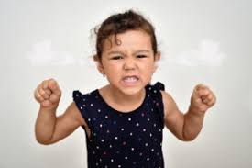
What is dysfunctional behaviour?
Environmental causes
psychological perspective - behavioural disorders as effects of psychological trauma experienced by the child, most often in his/her family environment,
social perspective - behaviour disorders as dysfunctional processes occurring in the school community
Behavioral disorders can result from:
the interaction of environmental factors (dysfunctions in the parenting environment, in particular child abuse)
biological factors (dysfunctions of the nervous system).
temperamental traits may be important in the development of such disorders

Slide 5
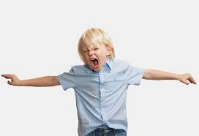
The case of Radek
9 years old, started school late, is considered a "difficult child"
During lessons: often does not take out his notebook, does not write down, gets up from the bench, walks around the classroom, plays with something and distracts his classmates.
When he is having a bad day, he is agitated, picks on children, calls them names, sometimes even hits them and defies the teacher (I won't do it!).
When an adult draws his attention to him, he does not react or responds rudely, sometimes uses vulgar language.
Sometimes he spoils the play of other children (when they don't want to let him in), and then complains to an adult when they push him away or challenge him.
He gets angry very easily when something goes wrong: he destroys a notebook, throws a book, sometimes utters vulgar words.
It happens that he runs out of the classroom during lessons or from the common room when something upsets him.
During excursions he behaves dangerously, e.g. goes out into the street on his own.
Often avoids eye contact.

Slide 6
Characteristics of disturbed behaviour
They are:
inadequate to the situation (the behaviour does not take into account the individual characteristics of the situation, is irrational, and thus seems strange or even shocking to those who observe it)
rigid (in various situations he presents a certain stereotype of behaviour - he reacts towards others in a provocative and aggressive way, regardless of the changing environment and people he/she comes into contact with; at the same time there is a lack of other patterns of behaviour e.g. cooperation, kindness, caring, etc.).
harmful for the person and the environment (Radek breaks the rules of school life, as well as social rules that determine how people relate to each other; his behaviour embarrasses others, disorganises lessons, hinders learning, provokes anger, helplessness, sometimes fear).
accompanied by unpleasant emotions (Radek is probably experiencing many difficult feelings: anger, anxiety, loneliness, etc.)

Slide 7
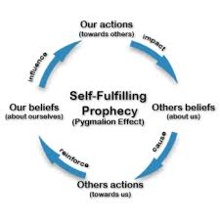
Family determinants of behavioural disorders
they moved from place to place
he was a witness of violence against mum, sometimes a confidant of his mum
his mum reacts with anger and punishes Radek with rejection (you are ungrateful, I don't talk to you, I will put you in an institution if you don't change)
he formed the belief that he was bad child and nobody wants him
The more often this pattern is repeated:
the more negative beliefs are recorded in the child's self-image,
the more often he/she repeats the bad behaviour, which then becomes habitual,
the less often he/she tries other, constructive behaviours.
The child " takes on" the role of the "bad child".

Slide 8
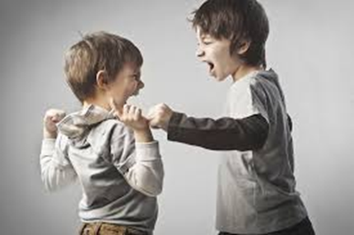
Behavioural disorders manifesting at school
Traumatic experiences
Experiencing family breakdown, threats, violence, rejection, lack of belonging
↓
Traumatic belief
I am bad
Nobody cares about me
Everybody wants to get rid of me
↓
Disturbed behaviour
During class, Radek gets angry and throws a pencil case at a colleague.
When the teacher tells him to pick up the pencil case and flush the boy out, he shouts to the lesser: I won't pick it up! What will you do to me?
Emotions
Feelings of insecurity
Powerlessness
Feelings of loss of control
Anger

Slide 9
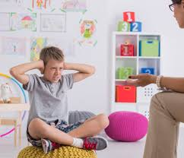
Distortion of the educational relationship
↓ ← ← ←
Traumatic belief
I am bad ↑
Nobody cares about me
Everybody wants to get rid of me ↑
↓
Disturbed behaviour ↑
During class, Radek gets angry and throws a pencil case at a colleague.
When the teacher tells him to pick up the pencil case and flush the boy out, he shouts to the lesser: I won't pick it up! What will you do to me?
↓ ↑
Educational message
You snot! You are unbearable!
You'll see, you'll get kicked out of this school! ↑
↓
→ → → →
Emotions
Feelings of insecurity
Powerlessness
Feelings of loss of control
Anger

Slide 10
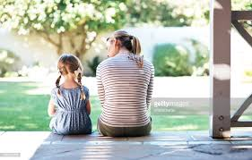
How to work with a child with behavioural disorders in the school environment?
Correcting experiences
Correcting experiences are social experiences that have the power to change rigid reaction patterns of the child, created as a result of psychological trauma
- does not confirm the child's ideas and expectations resulting from his previous experiences, conditioned by the traumas he has experienced (in Radek's case, it is mainly the belief: I am bad, nobody cares about me, everybody wants to get rid of me).
- helps the child to experience himself/herself and relationships with people in a different way (there are people who care about me, I can trust them; I can do good things, cooperate, etc.).

Slide 11
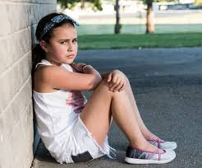
Difficult versus disordered Behaviour
A child's difficult behaviour
- may occur sporadically and be determined by specific reasons (e.g. bad mood of the child, difficult situation for him/her etc.)
- in such situations, it is usually sufficient for the educator , who sets clear expectations, gives appropriate support and intervenes when the child the child crosses the boundaries.
In the case of conduct disorder:
- there is an established pattern of behaviour, occurring frequently, inadequate to the situation and destructive
- then spontaneous educational measures are not enough
- there is a need for a well thought-out strategy of consistent correcting actions, well-adjusted to the problems of the child (based on problem diagnosis), implemented by all educators as far as possible.

Slide 12

Building strategies to correct the child's disordered behaviour at school
What can we count on?
actions based on a good analysis of the problem, targeted at specific goals - are
more effective than actions done "on the fly", often without thinking, chaotic and inconsistent.
the combined efforts of many people have more power to influence a child or a class than the individual work of each of them.
sharing responsibility with others, supporting each other, contributes to reducing the mental burden on teachers in difficult situations
TEAM
teachers and specialists (psychologist, therapists ..)

Slide 13

Rules of teamwork
1. the principle of openness and engagement: "We share our knowledge about the child in an open way".
2. the principle of respect for difference: "We have the right to differ in the way we see the child".
3. the principle of personal responsibility: "Everyone determines his/her own participation in the strategy".
4. the principle of positive reinforcement: "We value each person's ideas and involvement".
5. the principle of discretion and respect: "We only share information about a child and their family with people only to those who are authorised, trusted, for the benefit of the child and with respect".

Slide 14
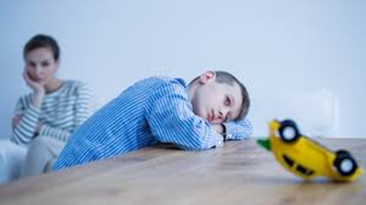
Graphical case analysis
Radek 9 years
Difficult child behaviour/difficult situations The child's strengths
Why does he behave this way? What works for him/her?
What does not work?
What does the child feel?
What does he/she need?
How can we help him/her, ideas for action?
Deciding what will be done by whom? When? How?

Slide 15
Description of difficult behaviour and search for the cause
1. CHALLENGING BEHAVIOUR
2. WHY DOES HE BEHAVE LIKE THIS?
During lessons: often does not take out his notebook, does not write down, gets up from the bench, walks around the classroom, plays with something and distracts his classmates.
When he is having a bad day, he is agitated, picks on children, calls them names, sometimes even hits them and defies the teacher (I won't do it!).
When an adult draws his attention to him, he does not react or responds rudely, sometimes uses vulgar language.
Sometimes he spoils the play of other children (when they don't want to let him in), and then complains to an adult when they push him away or challenge him.
He gets angry very easily when something goes wrong: he destroys a notebook, throws a book, sometimes utters vulgar words.
It happens that he runs out of the classroom during lessons or from the common room when something upsets him.
During excursions he behaves dangerously, e.g. goes out into the street on his own.
Often avoids eye contact.
He has had difficult experiences and suffered psychological trauma.
He is unable to cope with a state of agitation.
In this state he does not control his behaviour.
He is rejected by children in class.
He is unable to establish good contact with children.

Slide 16

STRENGTHS
he sometimes helps the teacher with specific tasks e.g. setting up the desks,
volunteers for duty and does it well,
when having a good day, tries to behave well and works in class,
has the ability to reflect on his/her behaviour, to apologise (on a one-to-one basis, when an adult
Is able to apologise (on a one-to-one basis when treated kindly by an adult),
Is bright when the teacher explains something to him/her on a one-to-one basis.
Likes nature and knows a lot about it
3. FEELINGS
Anger, jealousy when children are together, feelings of rejection, guilt and shame, sadness,
loneliness, feelings of injustice, helplessness when they cannot control themselves, discouragement
4. NEEDS
to belong to a class, to be supported by adults (parents and teachers) especially when he/she is in a state of agitation,
to have his/her bad behaviour interrupted, to be helped to learn self-control,
to have clear boundaries, to have consistency from adults combined with kindness and care,
to be able to pursue his/her interests, to show off, to succeed, etc.).

Slide 17

WHAT WORKS?
calmness and decisiveness of the adult
clear consequences
sometimes a warning from an adult works
short messages
praise, reward
sometimes he can control himself if you leave him alone for a while
WHAT DOESN'T WORK?
punishments,
Notes in the logbook,
shouting, threats, fighting,
long explanations and speeches by an adult.

Slide 18
IDEAS FOR ACTION
School psychologist:
Make, together with the class teacher, a contract with Radek on the basis of a " suspension of arms" principle with Radek. - "Radek, we don't want to fight with you, we want to help you". The aim of the contract is to motivate learning and behavioural change through small successes and positive feedback and through a points system (in cooperation with teachers).
Individual care for Radek (goals: behaviour control, emotional support, teaching constructive behaviour)
- Meeting Radek and supporting him in the realization of the contract, helping the boy to understand his own and others' behaviour, helping him to find constructive
solutions to difficult situations he is involved in, etc.
- working with the boy on teaching him to recognise his own states of wellbeing and
working out behaviours that can reduce agitation
- activities improving and compensating developmental deficits
Cooperation with mum - showing her the strategy worked out at school to help Radek,
Jointly setting the tasks for mum in this strategy.

Slide 19
Class teacher:
Individual project for Radek (using his interests) - e.g. preparing a guide for the class trip to the zoo with interesting information about all the animals (he could be supported in this task by an adult, e.g. the day-room teacher).
Implementation of a project for the whole class and providing an opportunity for cooperation and team integration.
Introducing the principle that each child is responsible for his/her behaviour to prevent the blame being put on Radek.
To develop with the class good ways to react to Radek's difficult behaviour.
Implementing the role of a student - Radek gradually learns the necessary behaviours, these are reinforced through the awarding of points (this system can be implemented in the whole class)
- sitting on the chair,
- taking out his book and notebook on the teacher's command,
- writing in the notebook,
- keeping quiet while working,
- asking for answers by raising hands,
Reinforcement: praise from the teacher, a treat at home agreed upon with mum, a reward - new school supplies, etc.
Preparation of class trips (for Radek, it is an opportunity to function better on an outing when there are clear rules and consequences for breaking them).
Pupils:
know where they are going, look forward to it as an important event,
rules of behaviour are established, e.g. on the street, in the cinema etc,
then the outing is summarised - what was good, what was bad, what was liked etc.
a child who blatantly breaks the rules does not take part in the next outing, but then is given the chance again.

Slide 20
All teachers:
Show Radek kind interest "I'm happy to see you... I care about you, you are important to me, I like you, I worry about you...
They try to establish individual contact with him, agree with him on certain rules of behaviour in class.
They encourage in moments of difficulty: "Radek, you can... you can do it... I know you can do it on your own..."
Reinforce Radek's expressions of cooperation in the form of descriptive praise: "Today you took on the task yourself and completed it to the end, ...you volunteered to answer and calmly waited until I asked you".
They give support when he fail: "It was difficult, but I saw It was difficult, but I saw that you tried - and that's what counts".
When he misbehaves they remind the rules: "Radek, we don't run around here", "We call each other by we call each other by our first name".
They set boundaries, firmly and with care: "I don't want you to call the kids names. I want you to have friends here, not enemies."
When Radek is agitated and begins to misbehave, they allow quiet in the classroom, as a last resort, Radek goes to the teacher's office, where he does the tasks on his own, that were in the lesson

Slide 21

Benefits of the method
The collection of all relevant information shows a complete picture of the child's or class's functioning and gives the basis for a good diagnosis of the problem.
The involvement of many teachers who teach the child gives the opportunity for well targeted and intensive actions.
Breaking the stereotypes of thinking about the child, opens the teachers to his/her needs and difficulties.
Structuring the work of the team, good use of time makes it possible to experience the satisfaction from effective cooperation, exchange of experience, increased hope for overcoming educational difficulties.
Greater awareness of problems increases the chances that teachers will notice them more quickly and react to them, which prevents them from increasing.

Slide 22

CONDITIONS FOR THE METHOD TO BE EFFECTIVE
1. the support of the school principal who:
a. expresses strong expectations regarding the responsibility of teachers in solving problems of difficult behaviour of students,
b. clearly defines the role of the school pedagogue or psychologist as a consultant and leader of the educational team
2. readiness of teachers to engage in educational work with students and to cooperate in building and implementing strategies of work with pupils who cause difficulties.
3. consistency in action - realizing one strategy is not enough. Those who decide to go down this road must persevere, overcome resistance in themselves and others, be brave and courageous. in themselves and in others, to change their style of action courageously.

Slide 23
References
Karasowska A., (2009), Profilaktyka na co dzień. Metoda budowania strategii w pracy z dzieckiem i klasą, Warszawa: PARPAMEDIA.
Karasowska A., (2006), Profilaktyka na co dzień. Jak wychowywać i uczyć dzieci z zaburzeniami zachowania., Warszawa: Wyd. Edukacyjne PARPA.
Sawicka K., (1999), Socjoterapia, Warszawa: Centrum Metodyczne Pomocy Psychologiczno-Pedagogicznej MEN,.
Skura M. (2020), Positive behavioural support at schools via designing supportive learning environments, Interdyscyplinarne Konteksty Pedagogiki Specjalnej, 31: 241-266. DOI: https://doi.org/10.14746/ikps.2020.310.11
Skura & Wheeler J. J.(2020); Zastosowanie Modelu Pozytywnej Interwencji i Wspierania Zachowań w pracy edukacyjnej i wychowawczej z uczniami ze specjalnymi potrzebami edukacyjnymi/ Application of the Model of Positive Behavioral Interventions and Supports in educational work with SEN students; Niepełnosprawność. Dyskursy Pedagogiki Specjalnej, 3 (39): 72-96;
Strzemieczny J., (1993), Zajęcia socjoterapeutyczne dla dzieci i młodzieży, Warszawa:PTP
Smith B., Fox L.(2003), Systems of service delivery: A synthesis of evidence relevant to young children at risk of or who have challenging behavior. Center for Evidence-based Practice: Young Children with Challenging Behavior. Available: www. challengingbehavior. org (Smith & Fox, 2003, p. 6)

Slide 24
After the break if we make it - workshop
1. case study
2. mind map
3. designed assistance

Slide 25
Task:
I would like to ask each of you to think about a child from your school who has behavioural and emotional problems.
I would like you individually or in groups to do a Graphical case analysis of this child
please write what the behavioural challenges are for this child
WHY DOES HE/ She BEHAVE LIKE THIS?
His/her FEELINGS
The STRENGTHS
His/her NEEDS
what works with this child and what does not work
and of course Ideas for action: for psychologist, for class teacher, for all teachers
You have my example of Radek and my solutions and help for the child

Slide 26
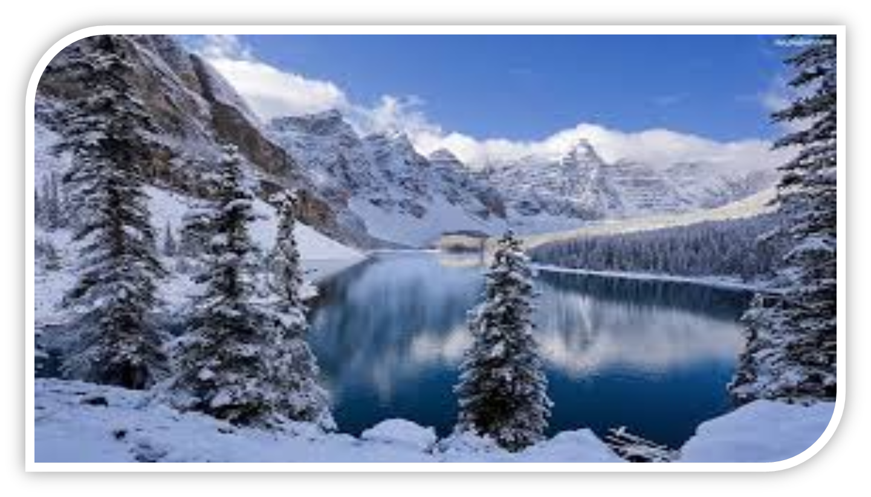
Thank you for your attention! ☺ გმადლობთ ყურადღებისთვის
Notes:
26

